Slide 1
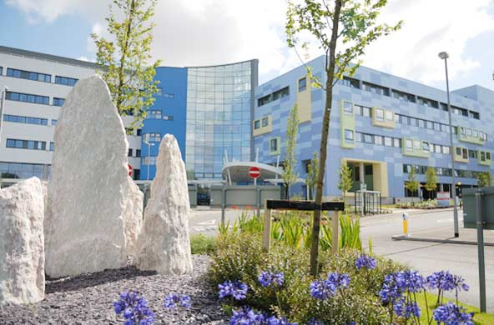
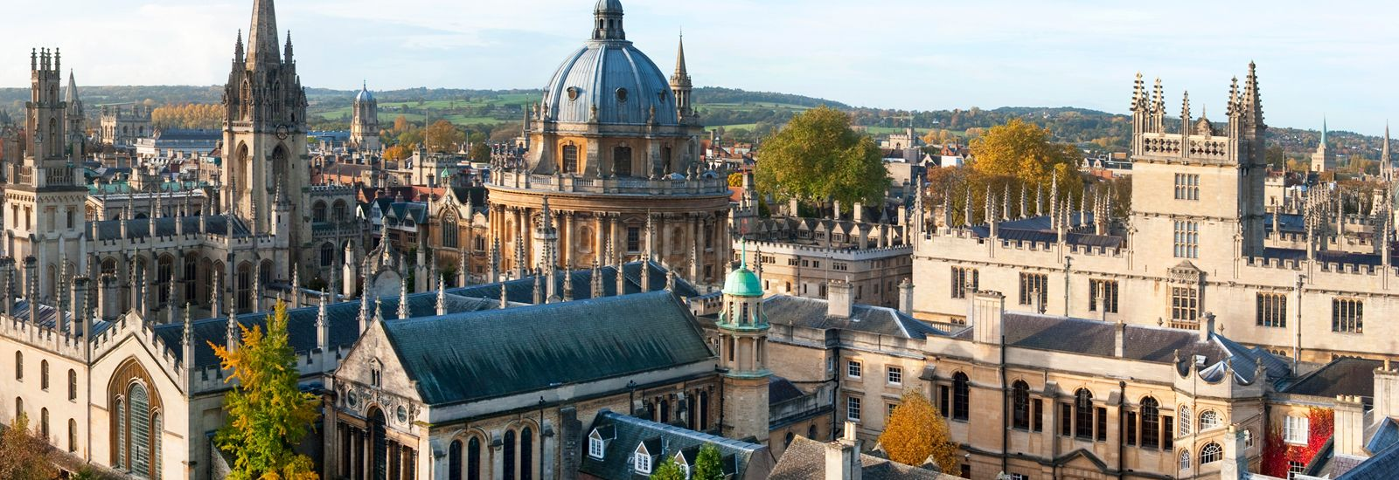
Oxford Hepatology ATP
Paired with Cambridge

Slide 2
Overview
9 months at the John Radcliffe Hospital, Oxford
3 months at Addenbrookes Hospital, Cambridge
Excellent general and sub-specialty clinical Hepatology experience
Outstanding educational and academic opportunities
Participation in out-of-hours Gastro/Hep on call rota (c. 1 in 8) (no GIM)

Slide 3
Oxford
Oxford Hepatology based at John Radcliffe Hospital with additional inpatient and outpatient Hepatology at the Horton Hospital in Banbury
18 bed ward (shared with Gastro)
Staffing includes 3 other regional registrars, 5 senior clinical fellows, 5 hepatology nurse specialists
Hepatology Day Case Unit
General and sub-specialty Hepatology clinics
Metabolic (fatty liver)
Viral Hepatitis
HCC
Autoimmune/PSC
Advanced Liver (decompensated cirrhosis, pre-transplant)
Post transplant
Endoscopy including Hepatology lists with emphasis on portal hypertension
Excellent links with interventional radiology, HPB surgery, oncology and Royal Free Hospital transplant unit

Slide 4
Typical week plan
 | Monday | Tues | Wed | Thur | Fri
Morning | Viral Hep clinic | Consultant W/R | Met Hep clinic | Ward round/ referrals/ day case | Journal club Adv Liv or ward round
Afternoon | Endoscopy/ward work | Ward work/ day case Hepatology/HPB XR meeting | Ward work/ audit | Department lunchtime meeting Registrar teaching Histopath meeting Hot cases/ academic meeting | Ward work

Slide 5
Hepatology Consultants (subspecialty interests)
Dr Jeremy Cobbold (Clinical Lead, Metabolic Hepatology, Cirrhosis- pre/post transplant)
Dr Jane Collier (HCC, Viral Hepatitis)
Dr Emma Culver (Autoimmune, cholestatic liver diseases, IgG4-RD)
Dr Tony Ellis (Horton Hospital- General Hepatology)
Dr Francesca Saffioti (Biliary Disease, Cirrhosis)
Prof Ellie Barnes (Honorary Consultant- Viral Hepatitis, HCC)
Dr Michael Pavlides (Honorary Consultant- Metabolic, Liver Imaging)

Slide 6
Enquiries welcome
Contact Dr Jeremy Cobbold, Consultant Hepatologist
Jeremy.cobbold@ouh.nhs.uk

